Slide 1
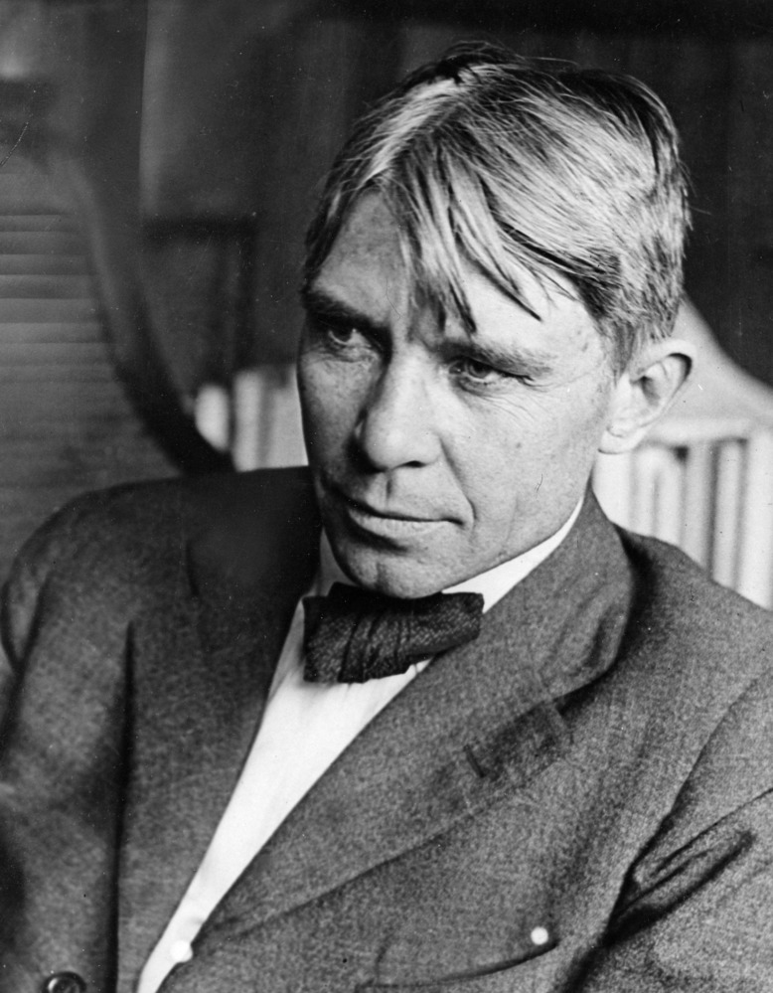
"Poet of the People“
Carl Sandburg provided a popular voice for the American people of the twentieth century and still speaks to us through his words, activism, music and the beauty and serenity of Carl Sandburg Home National Historic Site.
www.nps.gov/carl

Slide 2
Problems And Perspectives
Carl Sandburg lived during a time of great change in our country. He witnessed child labor, the labor rights movement, the Chicago race riots, segregation, the women’s suffrage movement, the Great Depression, World War I and II, and more.
​
As a journalist in the early 1900’s Sandburg often interviewed workers to hear their point of view, their problems, and their perspectives. As a poet, he reflected on the issue of Child Labor in numerous poems. ​
Regardless of the issue, how you experience something greatly influences your perspective and point of view about it. This lesson invites you to explore different points of view around Child Labor.
Tasks:
1. Read the poem "They will Say" by Carl Sandburg and an article about Child Labor.
2. Use the slides to explore child labor from different points of view.
3. Participate in a virtual “town hall” meeting around this issue by preparing a five-minute presentation from your chosen point of view.
4. Extension – Dig Deeper Photographic Analysis. Watch a video about the power of compelling images, and analyze a photograph from your “Point of View.”

Slide 3
Scenario
They Will Say
Of my city the worst that men will ever say is this:
You took little children away from the sun and the dew.
And the glimmers that played in the grass
under the great sky, And the reckless rain;
You put them between walls
To work, broken and smothered, for bread and wages,
To eat dust in their throats and die empty-hearted
For a little handful of pay on a few Saturday nights.
Carl Sandburg, Chicago Poems
You live in a small town in North Carolina in 1910. There is a large cotton mill in your town where many people are employed, including many young children. There will be a town hall meeting in your community to discuss the question: “Should children be working in the mill rather than attending school?”
Task: Read this article for background on Child Labor. https://www.history.com/topics/industrial-revolution/child-labor
Select one “Point of View” from the following slides, conduct research, answer the questions and prepare a presentation (per teacher guidance as a team or individual).
* There are 6 points of view, 2 examples of each: parent, child, journalist, cotton mill manager, social reformer, and politician.

Slide 4
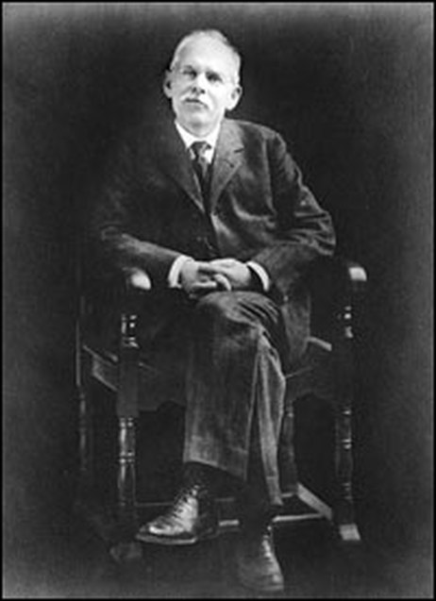
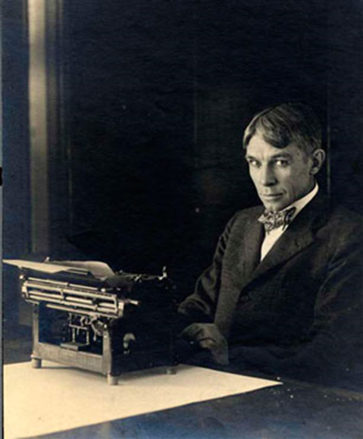
Point of View Journalist
Photo: Carl Sandburg as a News Correspondent, 1918
Credits: Carl Sandburg Home National Historic Site, CARL 7873
Point of View Journalist
Photo: Portrait of Jacob Riis Credits: Jacob A. Riis Collection, Museum of the City of New York
Background: Jacob Riis was a police reporter whose work appeared in several New York newspapers. His reports documented the living and working conditions of the poor. Through articles, books, photography, and lantern slide lectures, Riis served as a mediator between working-class, middle-class, and upper-class citizens. Riis argued for better housing, adequate lighting and sanitation, and the construction of city parks and playgrounds. He identified middle-class and upper-class citizens as benefactors and encouraged them to take an active role in defining and shaping their communities. Riis believed that charitable citizens would help the poor when they saw for themselves how "the other half" lived.
Background: Carl Sandburg wrote for a newspaper as a journalist. He also wrote poetry which was published in newspapers and journals. His words illuminated the human condition, especially for those who’s voice was not being heard, such as children working in factories, inhumane working conditions and the horrors of war and poverty.
Probative Questions:
1. In what ways could writers such as Sandburg use poetry and prose (fiction) to expose the horrors of the human condition?
2. Can you think of any other authors that have done this?
3. Can you think of other groups of people who ‘had no voice’? What do you think their involvement was with the labor movement?
4. By what means could one obtain the data necessary to write articles such as these? (i.e. interviews, letters, etc.) How was finding the material a challenge?
Probative Questions:
Why might the style and subject of Riis’s journalism be perceived as radical and innovative?
2. In what ways could the prominence of print culture (newspapers, books, pamphlets, articles, etc) effect progressive social movements, such as child labor reform?
3. Were other early twentieth century journalists and writers also exposing social injustices? In what ways were these works similar to those of Riis?

Slide 5
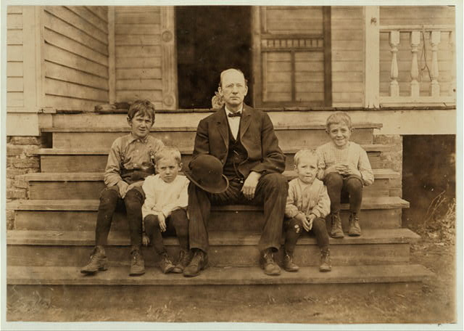
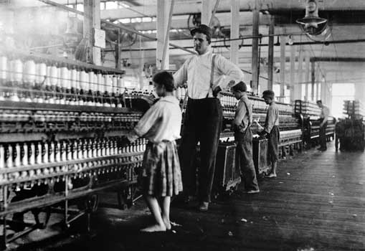
Point of View: Mill Employer
Photo: Mill Employer with Children, Chester, SC, Nov. 28, 1908
Credits: Library of Congress Collection. Hine, Lewis Wickes.
Point of View Mill Employer
Photo: Girl working in Yazoo City Yarn Mill, 1911
Credits: Library of Congress Collection. Hine, Lewis Wickes
Background: Mr. Smith, overseer in Wylie Mill, Chester, S.C. He will not let his own children work in the mill, and says it is no place for them. However, many children under the age of 12 work in his mill. He says that it is a common practice all through the South for employers in cotton mills to evade the child labor law by allowing young children to help their older sisters or brothers. The name of the younger sibling is kept from the books. "That is the way we manage it."
Background: Overseer supervising a girl (about 13 years old) operating a bobbin winding machine in the Yazoo City Yarn Mills, Mississippi.
Probative Questions:
1. Would it be possible for mill supervisors to care about their employees? Or to believe they are doing the children and their families a favor?
4. How might the laboring children have felt about their work?
5. Do you think they found it normal, necessary, and commonplace? Or brutal and unjust?
Probative Questions:
1. According to the background, what is Mr. Smith’s hypocrisy here?
2. For what reasons would Mr. Smith support child labor? For what reasons would he be against it?
3. Does Mr. Smith fit the stereotype of a dishonest businessman? Why or why not?

Slide 6
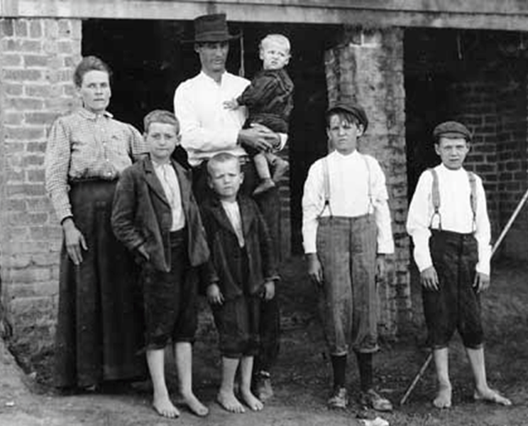
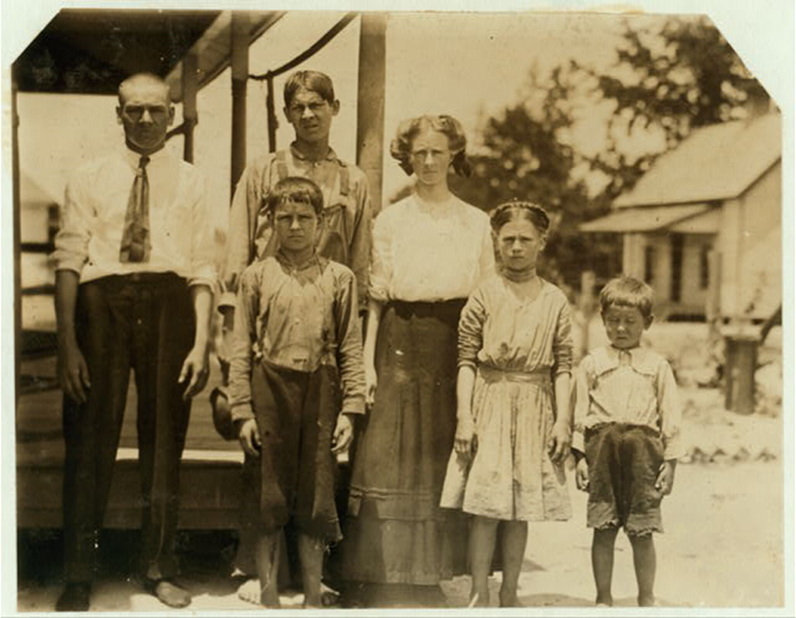
Point of View Parent
Photo: Family of Mill Workers in Fries, Virginia, 1913
Credits: Library of Congress Collection. Hine, Lewis Wickes.
Point of View: Parent
Photo: Parents & Children, 1912, Belton, SC
Credits: Library of Congress Collection. Hine, Lewis Wickes.
Background: A master of composition and mood, Lewis Hine used his camera for the cause of social reform. In 1908, he published a pictorial record of Ellis Island immigrants. In 1911, he was hired by the National Child Labor Committee as one of many “investigators” in the quest to document and portray the horrors of child labor through photographs.
Background: The Hopkins family. All of them, except the youngest, work in the mill owned by Belton Mfg. Co. The mom and daughter together run 10 sides for $1.10 a day. The daughter, almost 12 years old, can't write her name. One of the boys makes 50 cents a day sweeping. Three other children are not in the photo, but also work.
Probative Questions:
1. Why might a family like the one depicted here argue against the reform of child labor laws? (i.e. believe that child labor is okay)
2. How might the reform of child labor laws directly affect the social structure of families with previously employed children? (Hint: more free time for children, education, independence, etc.)
Probative Questions:
1. Why might have the Hopkins parents have a contradictory view of child labor­– finding it necessary but also being against it perhaps?
2. How may have family size affected a family’s view of child labor?
3. According to the background paragraph, what role could education and literacy have in child labor policy? Why?

Slide 7
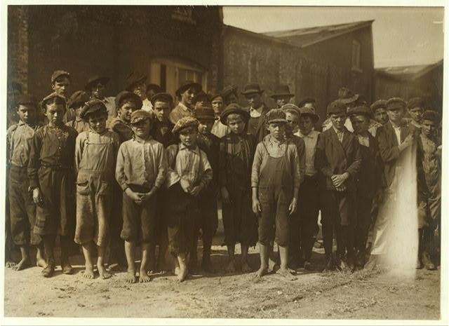
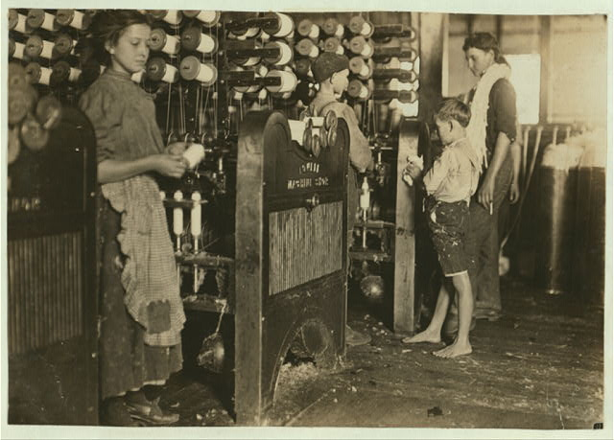
Point of View: Child
Photo: Child Workers, 1910, Pell City, AL
Credits: Library of Congress Collection. Hine, Lewis Wickes.
Point of View: Child
Photo: Children Working in Mill, 1908
Credits: Library of Congress Collection. Hine, Lewis Wickes.
Background: Some of the children working in the Pell City Cotton Mill. Mr. E.A. Thompson, Supt. of the Mill is also Mayor of Pell City.
Background: Picture of one of the smallest and youngest boys working in the mill at Cherryville Mfg. Co., Cherryville, NC.
Probative Questions:
1. How might have these children felt about their work? Do you think they found it normal, necessary, and commonplace? Or brutal and unjust?
2. Imagine these children were in a large impoverished family. If they realized the injustices of child labor and consequently refused to work, how could this affect their families?
3. What future do you have? Will you always work in a mill, or will you be able to learn another trade or skill? Could you become a mill owner? Would you want to?
Probative Questions:
1. How might these children have felt about their work? Do you think they found it normal, necessary, and commonplace? Or brutal and unjust?
2. Imagine these children were in a large impoverished family. If they realized the injustices of child labor and consequently refused to work, how could this affect their families?
3. What are some reasons the Mayors own children were not working in the mill?

Slide 8
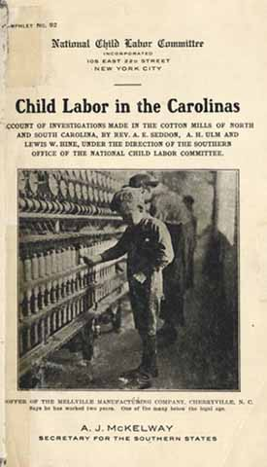
Point of View: Social Reformer
Photo: Child Labor Bulletin, 1913
Credits: Library of Congress Collection. Pamphlet using photographs by Hine, Lewis Wickes.
Point of View: Social Reformer
Photo: Child Labor Committee Poster
Credits: McKelway, Alexander Jeffrey
Background: A pamphlet produced as a result of the National Child Labor Committee’s investigation into child labor. Using photographs from Lewis Hines to illustrate their cause, they wanted the following reform. 1, no child under fourteen at work for wages. 2, no minor at work without regulation. 3. the eight hour day and no night work for under sixteen years. 4, working papers showing the child is old enough to work, the child is strong enough to work and the child has learned enough to work.
Background: Many reformers sought out ways to improve the quality of life for women and children in particular. Here is a poster which highlighted child labor in the fiber mills of North and South Carolina titled “Accounts of Investigations Made in the Cotton Mills of North and South Carolina,” by Rev. A. E. Seddon, A. H. Ulm and Lewis W. Hine, Under the Direction of the Southern Office of the National Child Labor Committee.
Probative Questions:
1. What specific changes in child labor policy was the author of this bulletin advocating for?
2. What audience was this bulletin targeted for? Where may have it been posted?
3. According to the author of the document, what was the role of the state in relation to child labor policy? Why was this controversial, specifically in the south?
Probative Questions:
1. What aspects of Southern culture and society likely acted as hindrances for activists attempting to improve labor laws?
2. How do you think investigations such as the one mentioned in the poster take place?
3. What class of people would likely disagree with arguments expressed in this source?

Slide 9
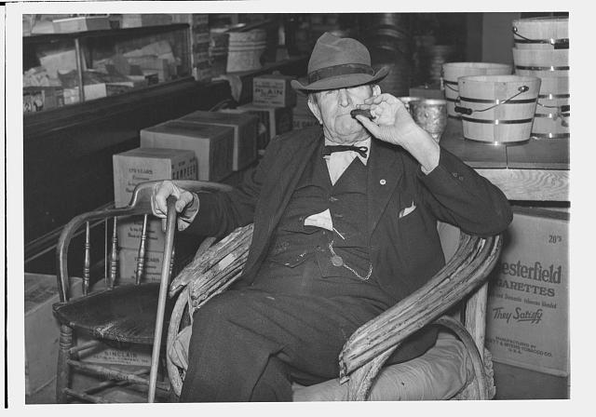
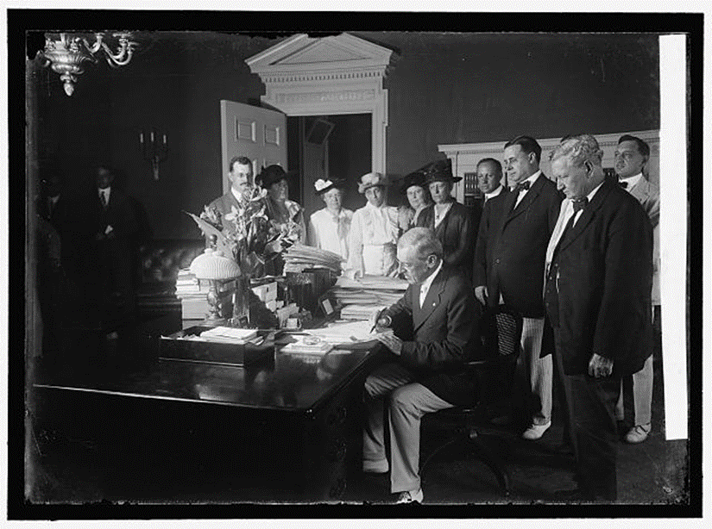
Point of View: Politician
Photo: Small Town Mayor, 1939
Credits: Wolcott, Marion Post
Point of View: Politician
Photo: President Woodrow Wilson signing Child Labor Legislation, 1916
Credits: Library of Congress Collection, Harris & Ewing photographers.
Background: R.B. Whitley is the mayor of and one of the first citizens of the town. He is also the owner of the general store, president of the bank, runs a cotton mill and owns the Whitley-Davis farm. He said he cut down the trees and pulled the stumps out of the main street, and was the first man in that town of Wendell, Wake County, North Carolina.
Background: This photo depicts president Woodrow Wilson signing the Keating-Owen Child Labor Act of 1916. This child labor act limited the work hours of children, forbade the interstate sale of goods produced by child labor, and began a new program of federal regulation in industry.
Probative Questions:
1. Why might Mr. Whitley have a conflict of interest with regards to child labor (as both a business man and public servant)?
2. How might the role of a small town mayor in child labor policy be different from that of a large city mayor?
3. Do you think it was common for business and politics to collide in small southern towns? Why or why not?
Probative Questions:
1. Why was this photo taken? (Why was this moment significant?)
2. Who would be negatively affected by the policy being signed here?
3. What was this photo likely used for? How may activists have employed it as a tool?

Slide 10
Problems And Perspectives Notes sheet
Use this page to answer the questions from your selected “Point of View.”
From your answers, prepare a five-minute presentation for the “town/class” to answer the question “Should children be working in the mill rather than attending school?”

Slide 11
Extension - Dig Deeper Photographic Analysis Form
The photographs of Lewis Hine were instrumental in the campaign for child labor reform. Watch the following video about his work to learn more. https://www.youtube.com/watch?v=ddiOJLuu2mo
After watching the video, go back to the “Point of View” slides and choose one of the images by Lewis Hine to evaluate using the chart on the next slide. Copy your image below for reference.
Copy photo here…

Slide 12
Objective Observation | Subjective Observation | Knowledge | Deduction
Describe what you see in the photograph—the forms and structures, the arrangement of the various elements. Avoid personal feelings or interpretations. Your description should help someone who has not seen the image to visualize it. | Describe your personal feelings, associations, and judgments about the image. Always anchor your subjective response in something that is seen. For example, “I see…, and it makes me think of…” | Describe prior knowledge that you can associate with this image including prior experience, study, assumptions, and intuitions. | What can you conclude about this photograph?

